Slide 1

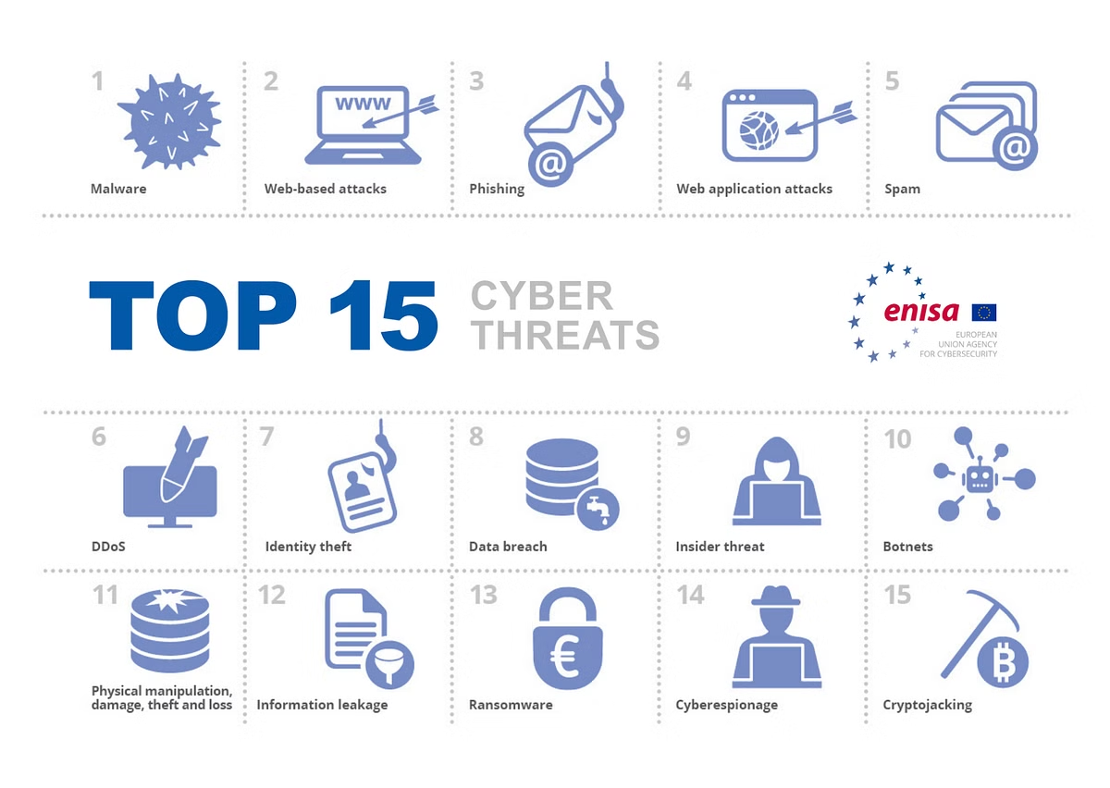
Defending Against Phishing Attacks
Phishing attacks are a major threat to organizations and individuals, as cybercriminals use deceptive tactics to steal sensitive information and gain unauthorized access. In this presentation, we will explore the different types of phishing attacks, learn how to recognize the warning signs, and discuss effective strategies to protect against these malicious attempts.
OA
By Lionel RAMANOU

Slide 2
Types of Phishing Attacks
Email Phishing
Spear Phishing
Whaling
The most common phishing method, where attackers send fraudulent emails impersonating legitimate entities to lure victims into clicking on malicious links or downloading infected attachments.
A more targeted attack where cybercriminals customize the email to a specific individual, using personal information to make the message appear more credible.
A type of spear phishing that targets high-profile individuals, such as executives or business leaders, with the goal of gaining access to sensitive company data or funds.

Slide 3

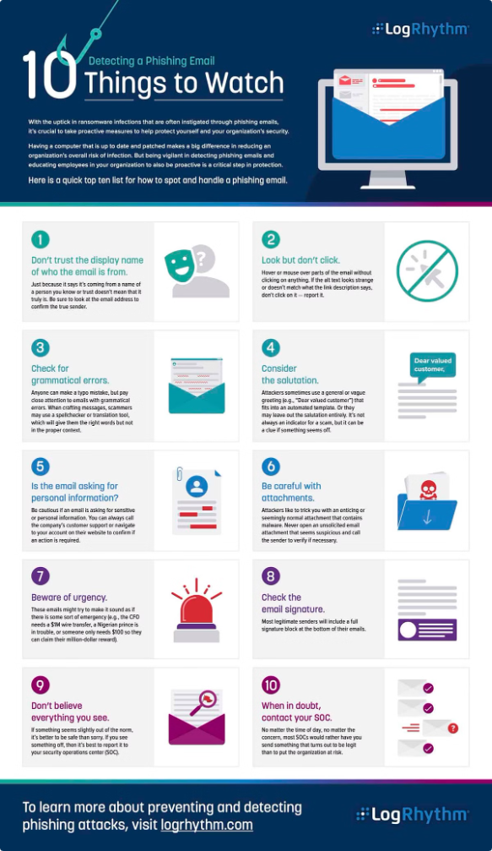
Recognizing Phishing Attempts
1
Suspicious Sender Address
2
Dubious Links and Attachments
Be wary of emails from unfamiliar or slightly modified addresses, such as admin@amzon.com instead of admin@amazon.com.
Hover over links to check the actual URL before clicking, and avoid opening unexpected or suspicious attachments.
3
Sense of Urgency
4
Poorly Designed Websites
Phishing emails often create a false sense of urgency to pressure victims into taking immediate action, such as "Your account will be suspended in 24 hours."
Phishing sites may have incorrect URLs, lack SSL certificates, or have low-quality logos and layouts compared to the genuine website.

Slide 4
Real-World Phishing Attacks
Sony Pictures Phishing Attack (2014)
COVID-19 Phishing Scams
Employees at Sony Pictures received phishing emails that led to the exposure of sensitive information, including unreleased movies and personal data.
Cybercriminals exploited the fear and uncertainty during the pandemic by sending phishing emails impersonating the World Health Organization (WHO) and asking for personal information or fraudulent donations.
Smishing (SMS Phishing)
Vishing (Voice Phishing)
Fraudulent text messages claiming to be from a bank and urging victims to click on a link to verify their account information have resulted in many people losing their financial data and funds.
Attackers impersonate trusted entities over the phone to trick victims into providing sensitive information, such as login credentials or credit card numbers.

Slide 5

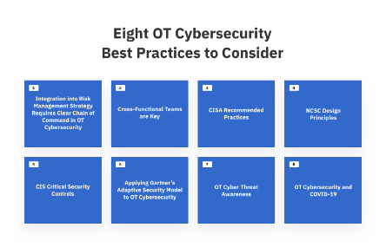




Protecting Against Phishing Attacks
Verify Email Senders
Inspect Links and Attachments
Enable Two-Factor Authentication
Beware of Public Wi-Fi
Check the sender's email address for any suspicious details or slight variations from the legitimate entity.
Avoid entering sensitive information on public Wi-Fi networks, as they may be vulnerable to eavesdropping and man-in-the-middle attacks.
Hover over links to inspect the URL before clicking, and avoid opening unexpected or suspicious attachments.
Use two-factor authentication whenever possible to add an extra layer of security to your online accounts.

Slide 6


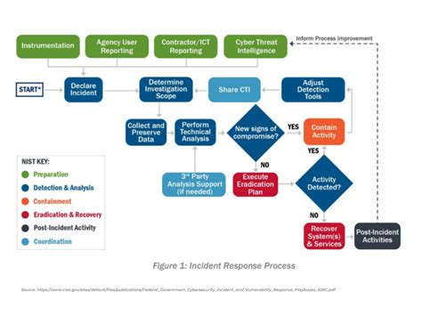


Responding to a Phishing Attack
Reset Passwords
If you have been a victim of a phishing attack, immediately change your passwords to prevent further unauthorized access.
Monitor Accounts
Regularly review your online accounts and financial statements for any suspicious activity and report any incidents to the appropriate authorities.
Notify the Organization
In a professional setting, inform your organization's IT security team about the phishing attempt to help them investigate and prevent future attacks.

Slide 7

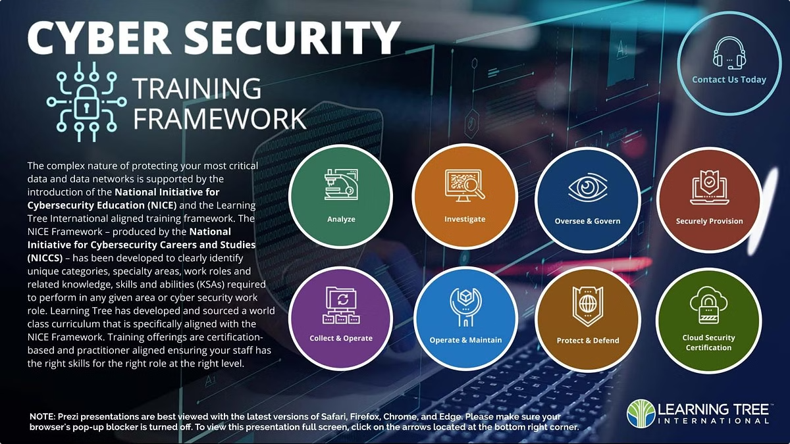
Phishing Awareness Training
1
Interactive Scenarios
Create engaging, interactive scenarios where users must identify phishing emails and other suspicious activities, reinforcing their ability to recognize such threats.
2
Phishing Simulation Quizzes
Develop quizzes that test users' knowledge and ability to detect phishing attempts, helping to assess the effectiveness of the training and identify areas for further improvement.
3
Continuous Reinforcement
Implement regular phishing awareness training and simulations to keep employees vigilant and up-to-date on the latest phishing tactics, ensuring a strong security posture over time.

Slide 8

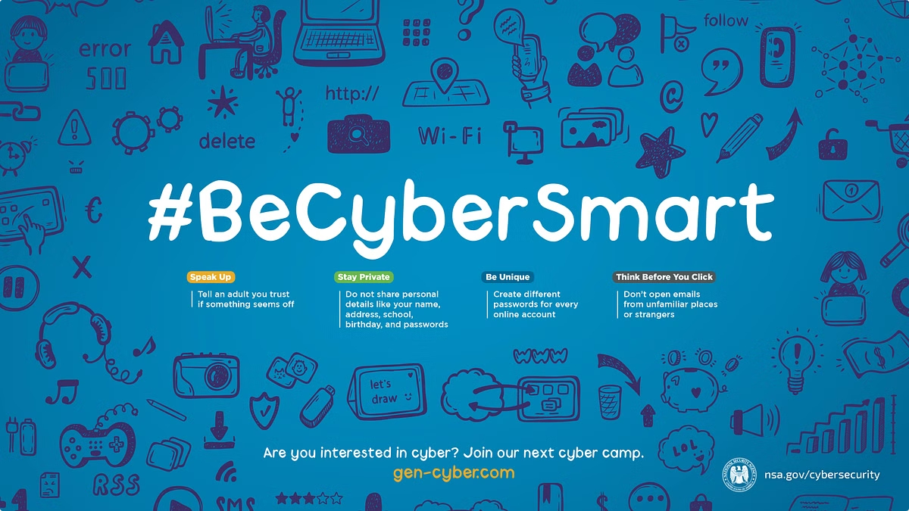
Conclusion
Key Takeaways
- Phishing attacks are a significant threat, using deception to steal sensitive information - Recognizing the warning signs, such as suspicious emails and websites, is crucial - Implementing strong security measures, like two-factor authentication, can help prevent attacks - Responding quickly and effectively, by resetting passwords and notifying authorities, can mitigate the impact of a successful attack - Ongoing phishing awareness training is essential to keep employees vigilant and informed

